Slide 1

AUTOGRAPH SOUND
MEZZANINE & STEEL PARTITIONING

Slide 2

BACKGROUND
Autograph Sound recently celebrated 50 Years after being founded in 1973 by sound designer Andrew Bruce who was working at the Royal Opera House, when he was approached by a well known theatre producer – with concerns about the sound quality for West End Productions.
Andrew took on the challenge and was promptly invited to design and rent to the producer a sound system that worked and had the quality that was missing from stage shows at the time.
Autograph Sound was born, and the stage was set to provide exceptional quality sound to theatres and live events across the world.

Slide 3
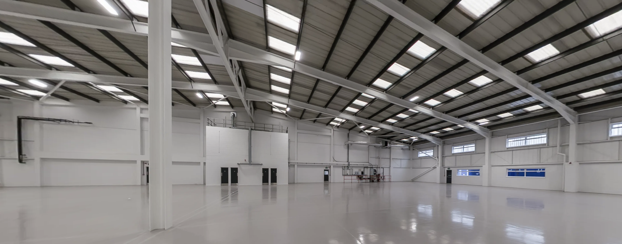
CHALLENGE
STS first got involved with Autograph Sound when we were employed back in 2016 to supply and install a mezzanine floor in their warehouse facility at Tufnell Park. With their 10 Year Lease Agreement coming to an end in 2026 at Tufnell Park, Autograph Sound went searching for a new larger unit to continue and expand their operation and storage capacity. We were approached in 2025 by their Operations Director Jon Sealey to supply and install a mezzanine floor with new Offices and Workshop rooms at their new proposed unit in Greenford.
We worked closely with Jon on the mezzanine design and shape and eventually an office layout that could accommodate all of the staff and operations required in the new space on and off the mezzanine floor.

Slide 4
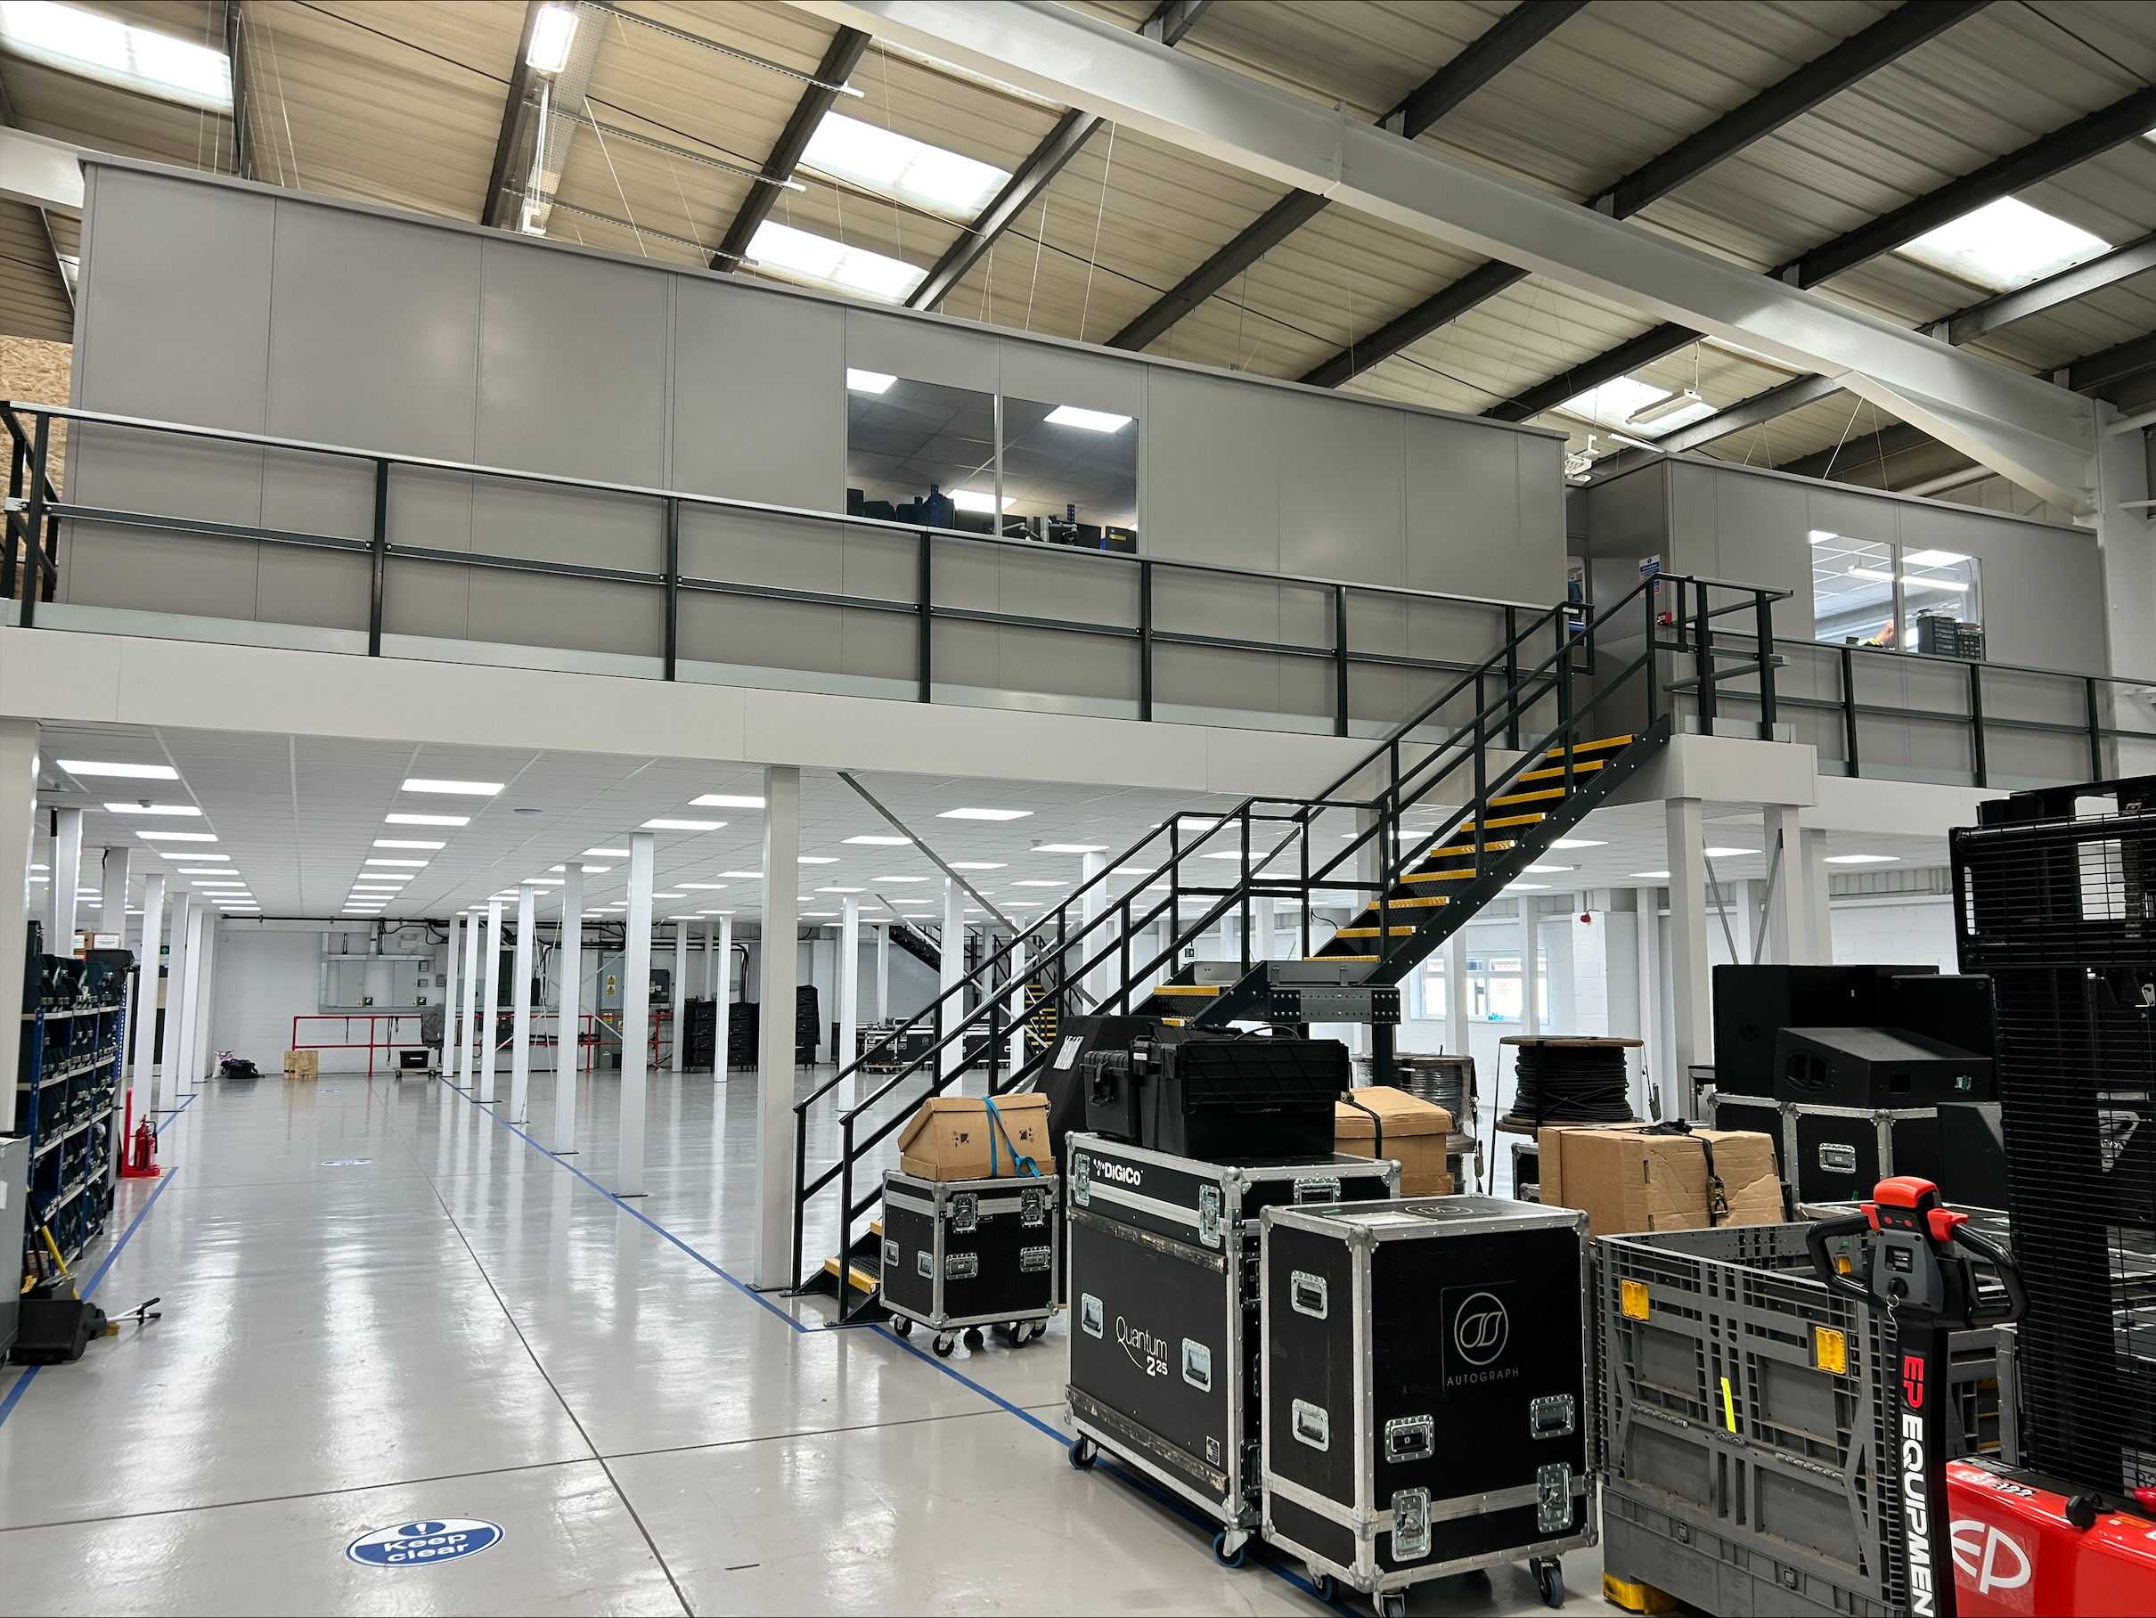
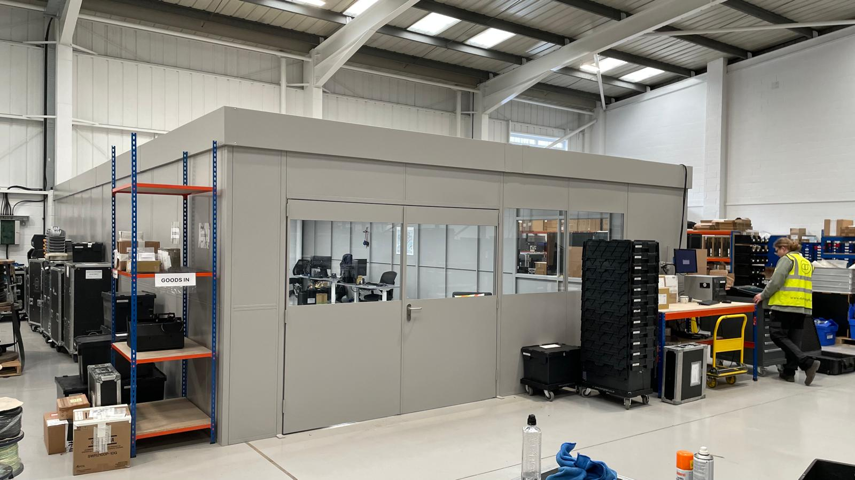
THE SOLUTION
28 metres x 25.9 metres
671.34m² Mezzanine Floor
3400mm Finish Floor
Mezzanine Height to match finish floor level of the existing civil mezzanine so level access between the two floors was possible.
An Opening and Fire Door was Fitted to access between the two floors
Fire Protection (600x600 Suspended Ceiling, Column Casings and Fascia)
59 Linear Metres of First Floor Single Skin Steel Partitioning on the mezzanine with suspended ceiling for warehouse office and workshops.
31 Linear Metres of Ground Floor Single Skin Steel Partitioning with ceiling fitted outside mezzanine area

Slide 5
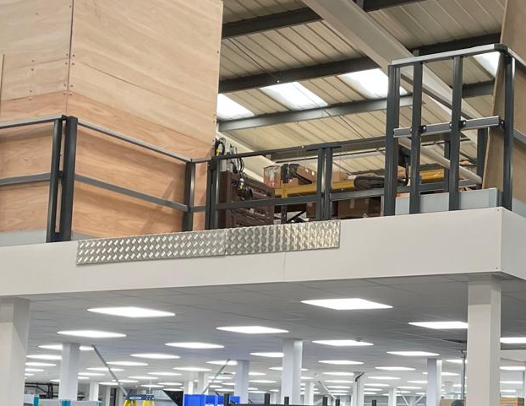
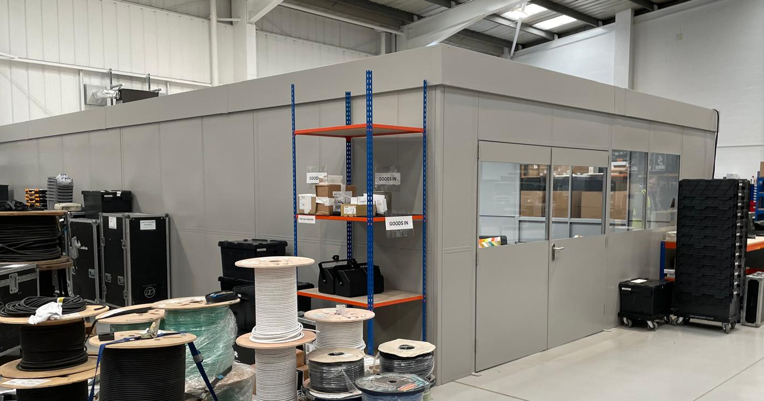
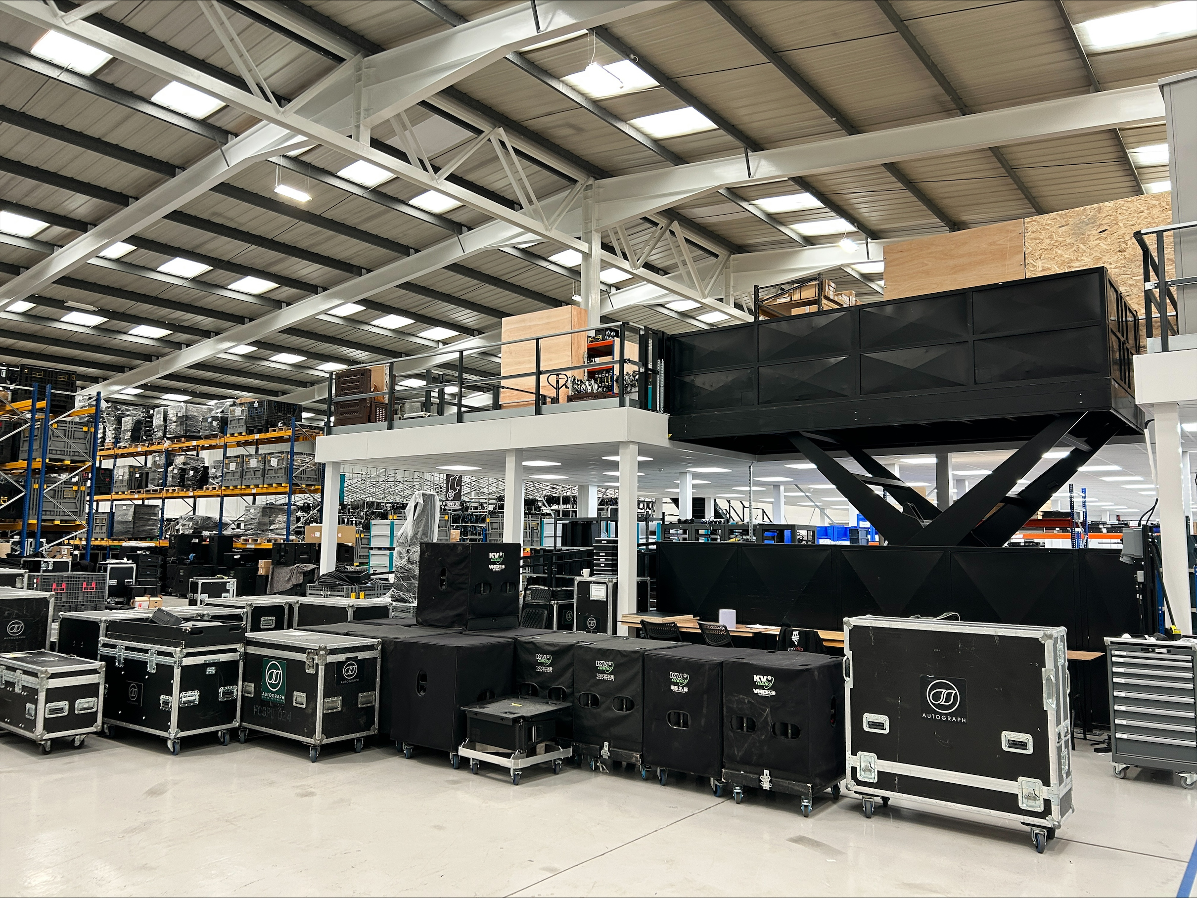
HOW WE DID IT
Mezzanine Floor designed for 4.8knm2 loading
Mezzanine Fitted with Two General Access Staircases and Utility Escape Staircase installed and Inset Pallet Gate fitted to one edge
Cut Out was made to accommodate the large goods lift platform relocated from the old site
2.4 Metres High First Floor and Ground Floor Warehouse Office - Manufactured from Single Skin Troax Sigma Steel Partitioning with glazing fitted with 600x600mm ceiling tiles fitted to both areas.
On The First Floor 2 sets of double doors fitted and one single door fitted and on the Ground Floor one set of double doors fitted (all lockable) and finished in Grey RAL 7037 Powder Coated Paint.

